Slide 1

COMPUTER NETWORKS (BCSC 0008)
Copyright content, use only with the written permission of presenter mentioned
Lecture 5

Slide 2
Transmission Media

Slide 3
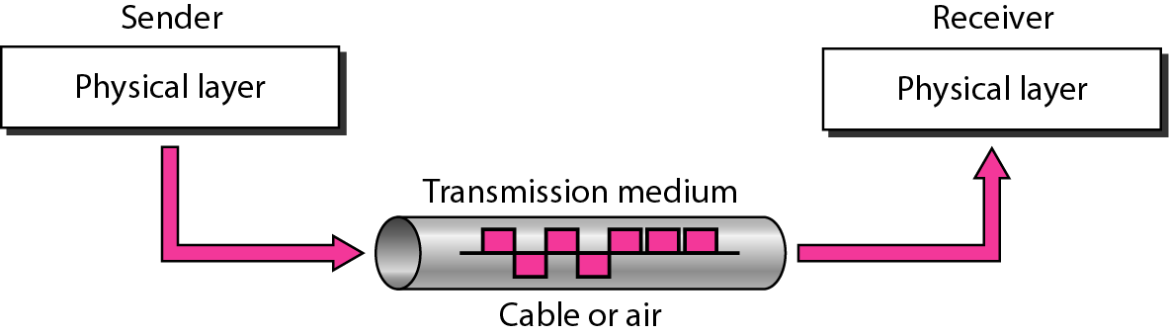
Figure 1 Transmission medium and physical layer

Slide 4
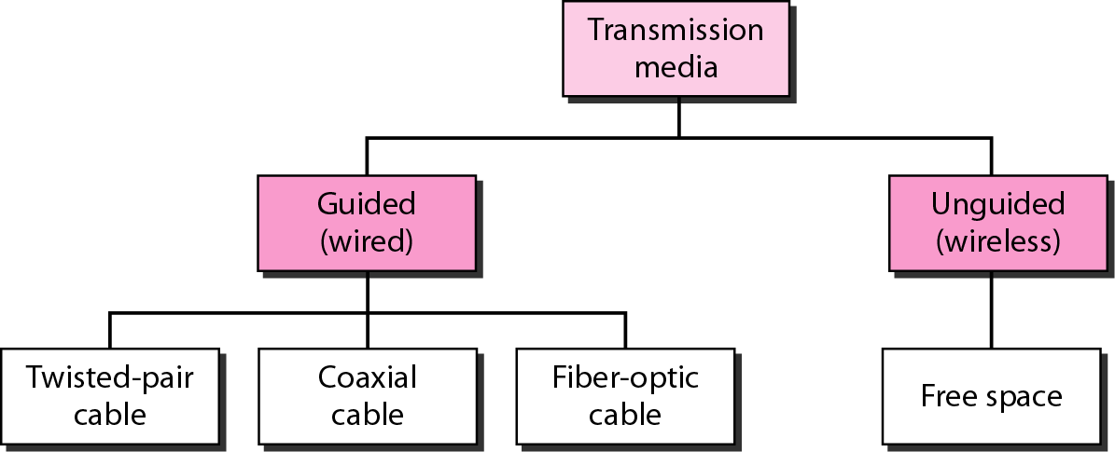
Figure 2 Classes of transmission media

Slide 5
GUIDED MEDIA
Guided media, which are those that provide a conduit from one device to another, include twisted-pair cable, coaxial cable, and fiber-optic cable.
Topics discussed in this section:
Twisted-Pair Cable Coaxial Cable Fiber-Optic Cable

Slide 6

Figure 3 Twisted-pair cable

Slide 7
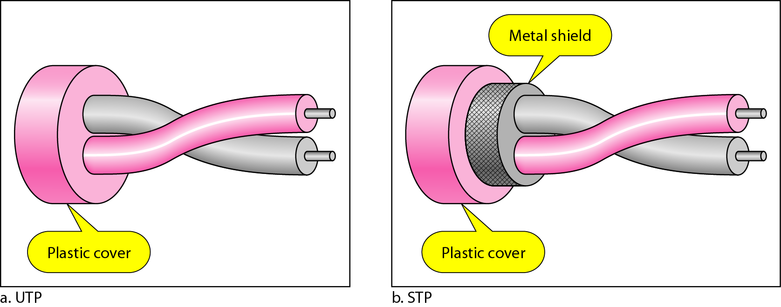
Figure 4 UTP and STP cables

Slide 8
Table 7.1 Categories of unshielded twisted-pair cables

Slide 9
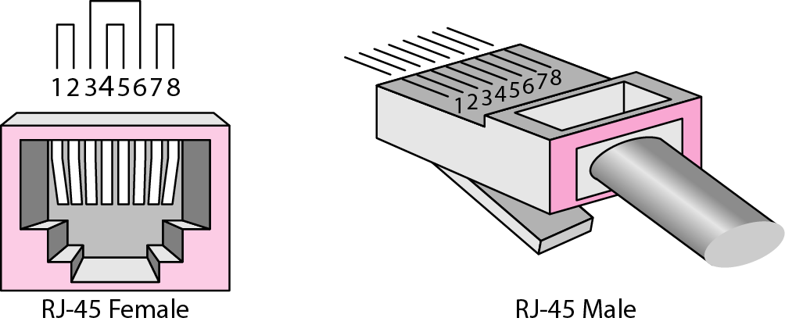
Figure 5 UTP connector

Slide 10
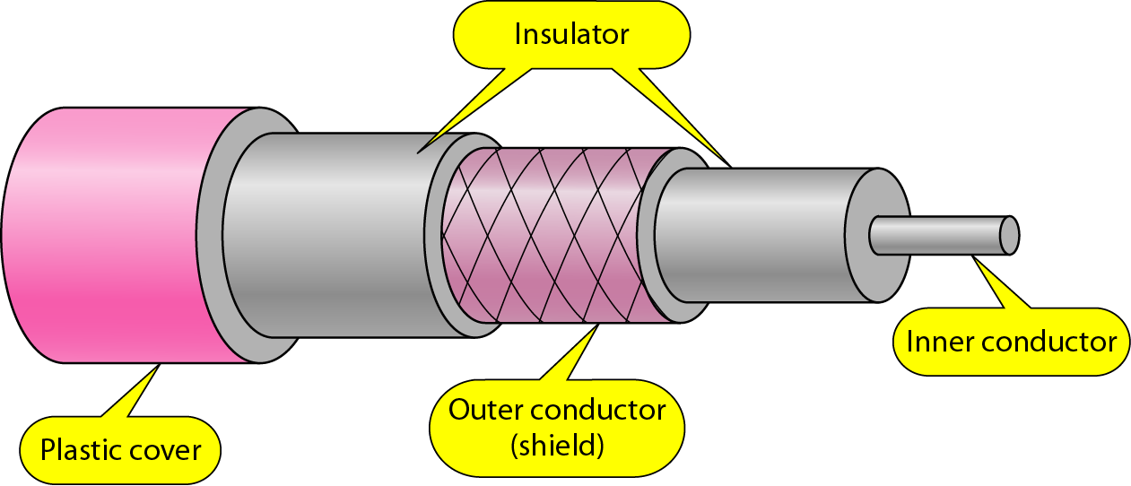
Figure 7 Coaxial cable

Slide 11
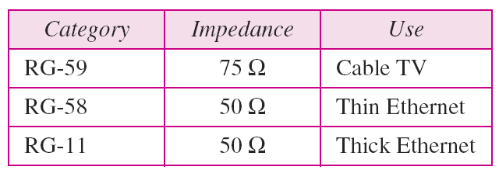
Table 7.2 Categories of coaxial cables

Slide 12
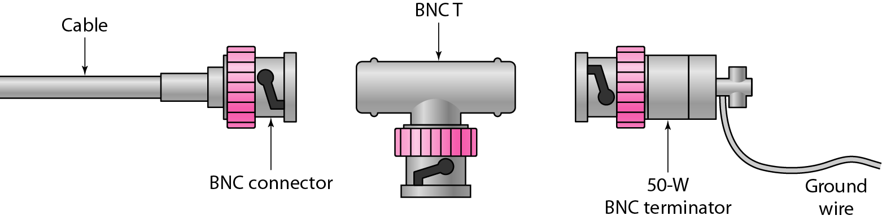
Figure 7.8 BNC connectors

Slide 13
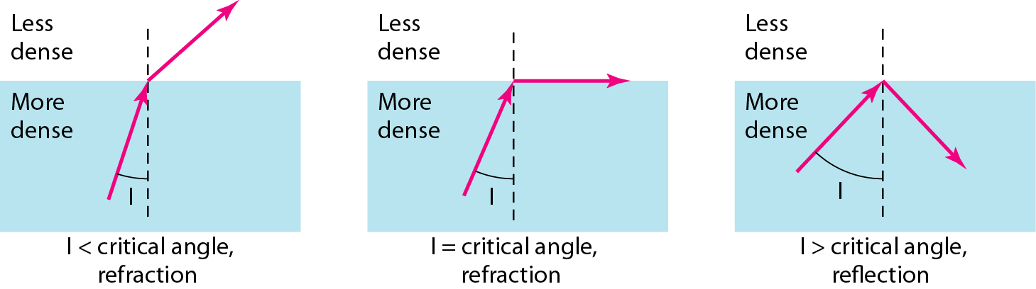
Fiber optics: Bending of light ray

Slide 14
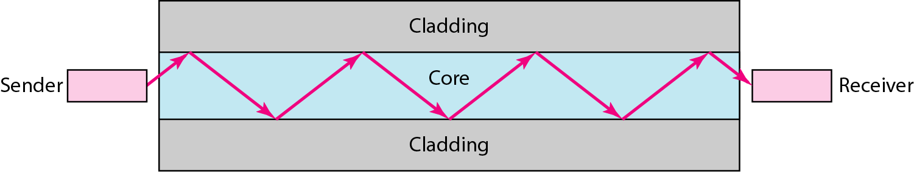
Figure Optical fiber

Slide 15
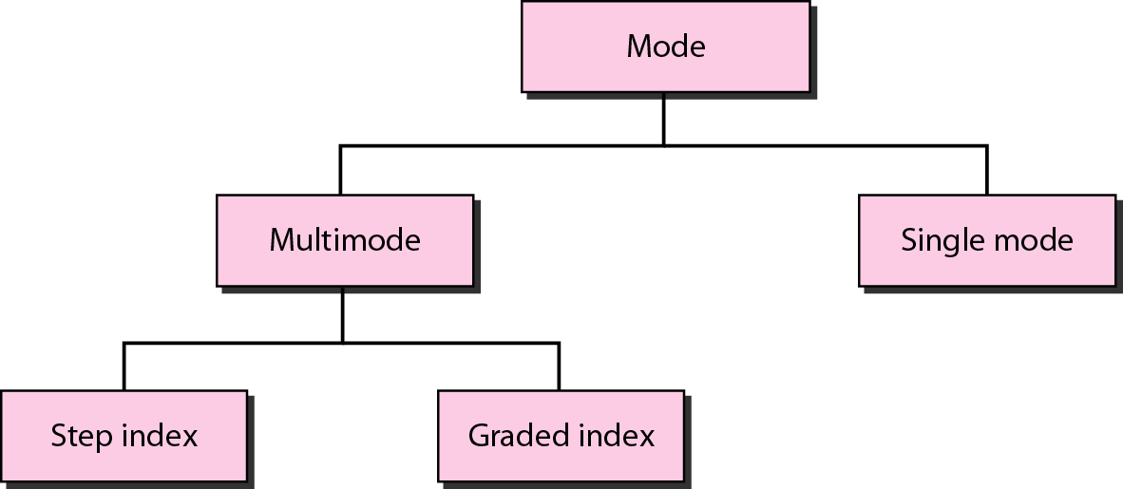
Figure Propagation modes

Slide 16
Modes of Propagation
Single Mode
One mode propagation
Inside fiber has only one group velocity
Multimode
Simultaneous propagation of many several modes
Each having own group of velocity
Step Index Fiber
Graded Index Fiber

Slide 17
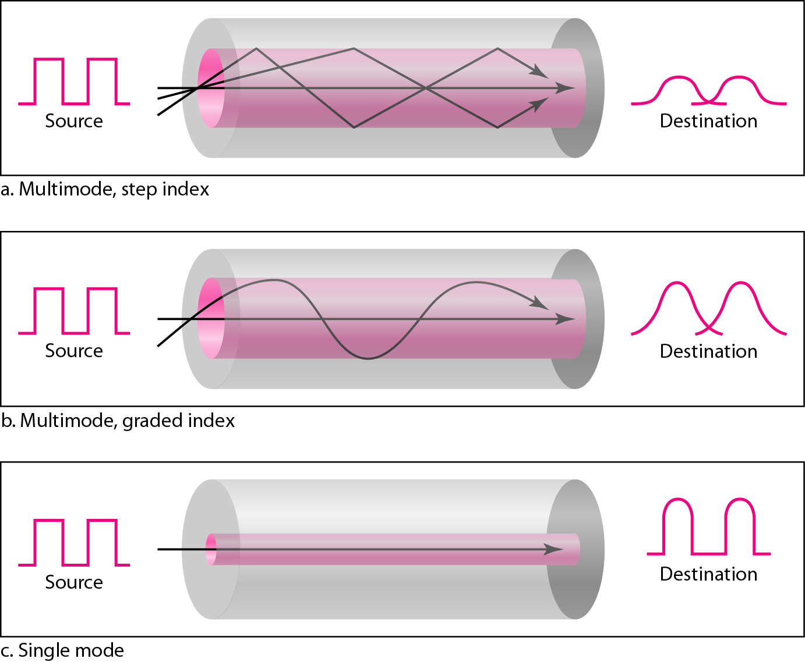
Figure 7.13 Modes

Slide 18
Table 7.3 Fiber types

Slide 19
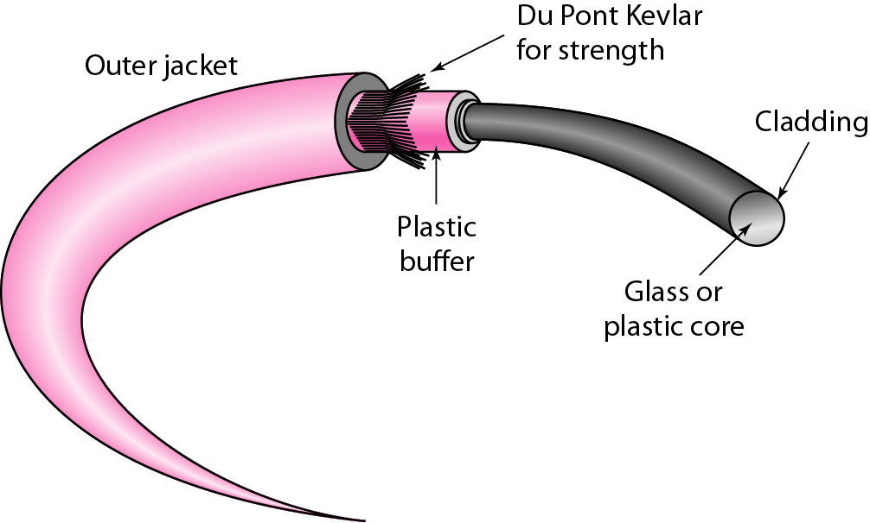
Figure 7.14 Fiber construction

Slide 20
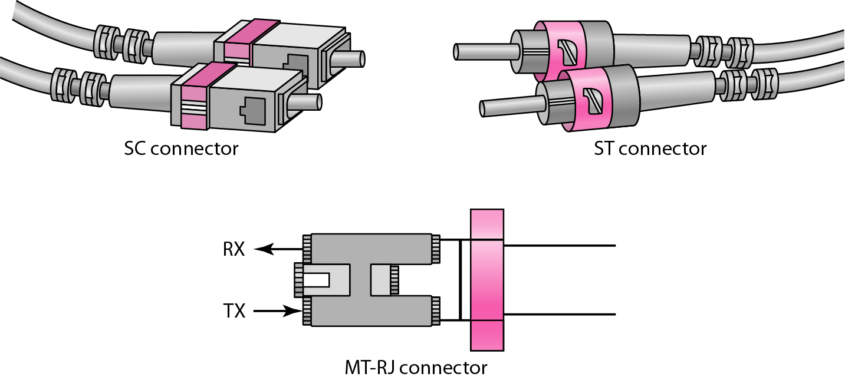
Figure Fiber-optic cable connectors

Slide 21
UNGUIDED MEDIA: WIRELESS
Unguided media transport electromagnetic waves without using a physical conductor. This type of communication is often referred to as wireless communication.
Topics discussed in this section:
Radio Waves
Microwaves
Infrared

Slide 22
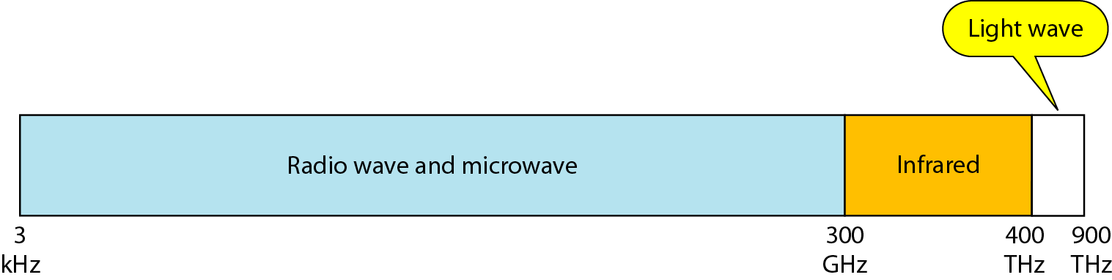
Figure 7.17 Electromagnetic spectrum for wireless communication

Slide 23
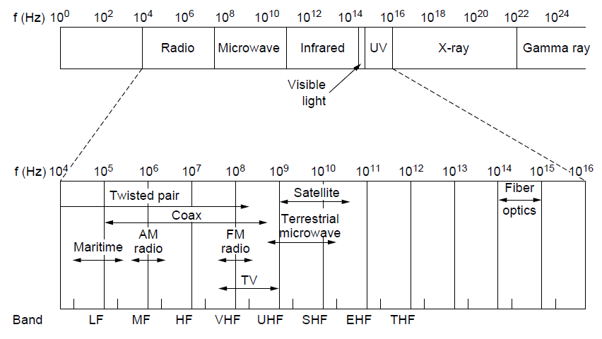
The Electromagnetic Spectrum (1)
The electromagnetic spectrum and its uses for communication

Slide 24
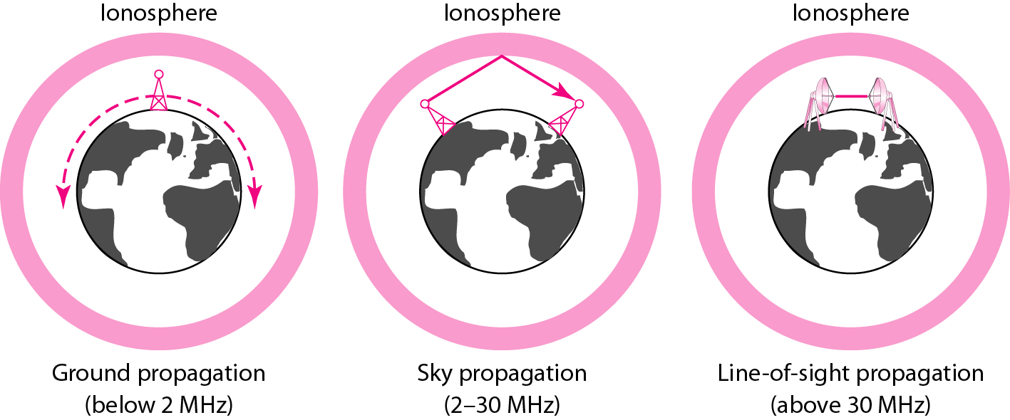
Figure Propagation methods

Slide 25
Table 7.4 Bands

Slide 26
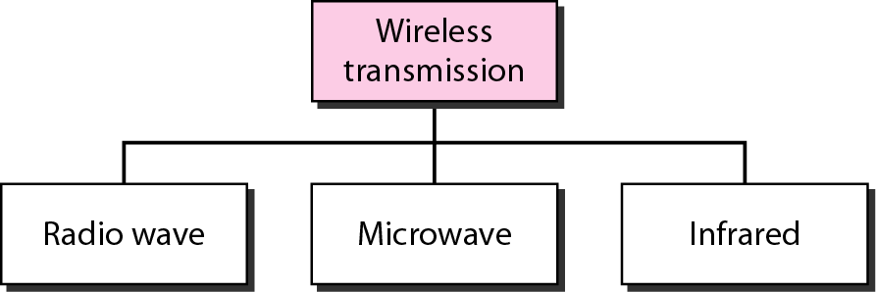
Figure 7.19 Wireless transmission waves

Slide 27

Note
Radio waves are used for multicast communications, such as radio and television, and paging systems. They can penetrate through walls.
Highly regulated. Use omni directional antennas

Slide 28
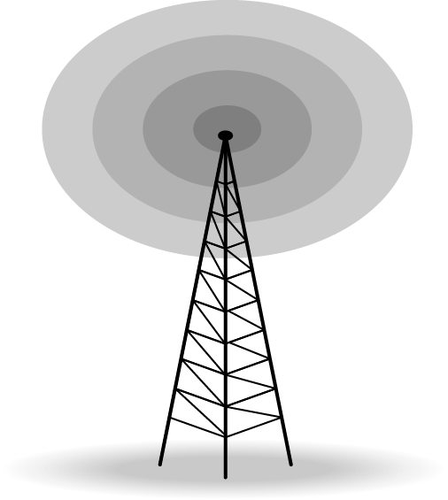
Figure Omnidirectional antenna

Slide 29
Note
Microwaves are used for unicast communication such as cellular telephones, satellite networks, and wireless LANs.
Higher frequency ranges cannot penetrate walls.
Use directional antennas - point to point line of sight communications.

Slide 30
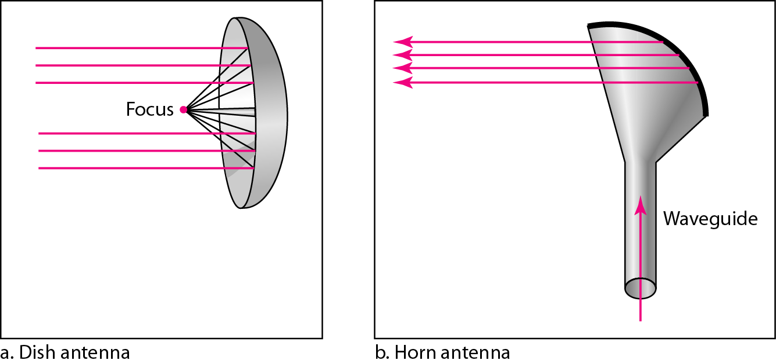
Figure 7.21 Unidirectional antennas

Slide 31
Note
Infrared signals can be used for short-range communication in a closed area using line-of-sight propagation.

Slide 32
Wireless Channels
Are subject to a lot more errors than guided media channels.
Interference is one cause for errors, can be circumvented with high SNR.
The higher the SNR the less capacity is available for transmission due to the broadcast nature of the channel.
Channel also subject to fading and no coverage holes.

